Slide 1
Graph Algorithm

Slide 2
Prim's Spanning Tree Algorithm
Prim's algorithm to find minimum cost spanning tree (as Kruskal's algorithm) uses the greedy approach.
Prim's algorithm shares a similarity with the shortest path algorithms.
Prim's algorithm, in contrast with Kruskal's algorithm, treats the nodes as a single tree and keeps on adding new nodes to the spanning tree from the given graph.

Slide 3
Prim's Algorithm Steps
Step 1 - Remove all loops and parallel edges
Step 2 - Choose any arbitrary node as root node
Step 3 - Check outgoing edges and select the one with less cost
Step 4 - Keep repeating step 3 until we get a minimum spanning tree
Notes:
Step 2 Description: any node can be the root node. One may wonder why any video can be a root node. So the answer is, in the spanning tree all the nodes of a graph are included and because it is connected then there must be at least one edge, which will join it to the rest of the tree.

Slide 4
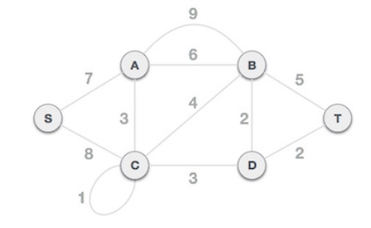
Prim's Algorithm
To contrast with Kruskal's algorithm and to understand Prim's algorithm better
Consider the following graph:
Vertices = 6
Edges = 11
MST = 5

Slide 5
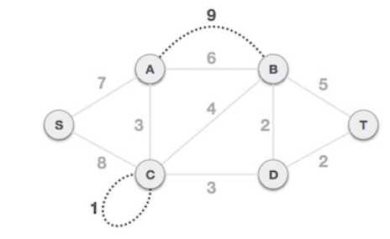
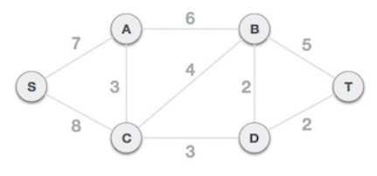
Prim's Algorithm
Step 1 - Remove all loops and Parallel Edges
In case of parallel edges, keep the one which has the least cost associated and remove all others.

Slide 6
Prim's Algorithm
Step 2 - Choose any arbitrary node as root node
We choose S node as the root node of Prim's spanning tree.
This node is arbitrarily chosen, so any node can be the root node.
Why any node can be a root node?
In the spanning tree all the nodes of a graph are included and because it is connected then there must be at least one edge, which will join it to the rest of the tree.

Slide 7
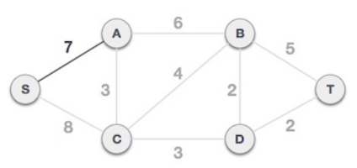
Prim's Algorithm
Step 3 - Check outgoing edges and select the one with less cost
Choosing the root node S, (S,A) and (S,C) are two edges with weight 7 and 8, respectively.
Choose the edge (S,A) as it has low cost than the (S,C).

Slide 8
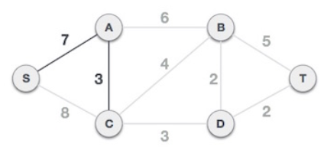
Prim's Algorithm
Step 3 - Check outgoing edges and select the one with less cost
Tree (S-7-A) or (S-A) is treated as one node.
Check for all edges going out from it.
Select the one which has the lowest cost and include it in the tree.
Choose the edge (A,C) with cost 3, as (A,B) has cost 6

Slide 9
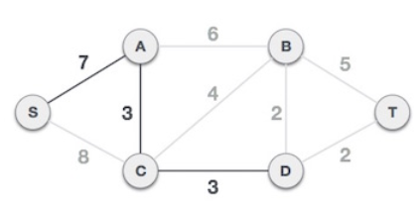
Prim's Algorithm
Step 3 - Check outgoing edges and select the one with less cost.
(S-7-A-3-C) or (S-A-C) tree is formed.
Treat it as a node and will check all the edges again.
Choose only the least cost edge.
(C-3-D) or (C,D) is the new edge, which is less than other edges' cost 8, 6, 4, etc.
.

Slide 10
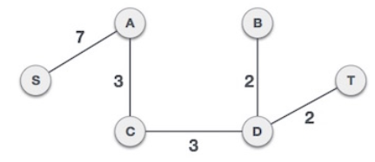
Prim's Algorithm
Step 3 - Check outgoing edges and select the one with less cost.
After adding node D to the spanning tree.
Have two edges going out of it having the same cost, i.e., (D-2-T) or (D,T) and (D-2-B) or (D,B), add either one.
But the next step will again yield edge 2 as the least cost.
Hence, a spanning tree with both edges included is created.

Slide 11
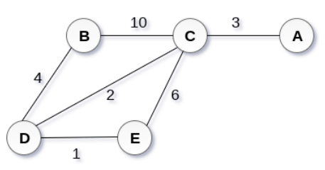
Prim’s Algorithm Exercise
Construct a minimum spanning tree of the graph using prim's algorithm.

Slide 12

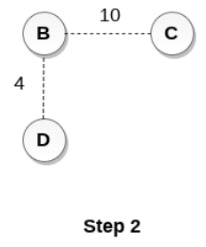
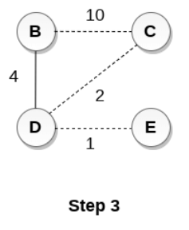
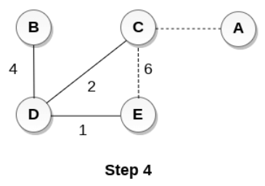
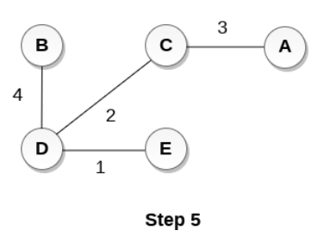

Slide 13
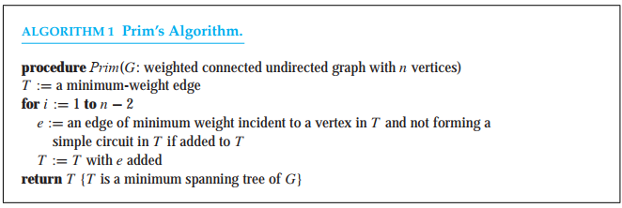
Prim’s Algorithm
Begin by choosing any edge with smallest weight, putting it into the spanning tree. Successively add to the tree edges of minimum weight that are incident to a vertex already in the tree, never forming a simple circuit with those edges already in the tree

Slide 14
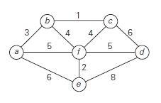
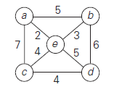
Prim’s Algorithm
A – B – C – F- E – F - D
A – E – B – E – C - D
MST = 15
MST = 13

Slide 15
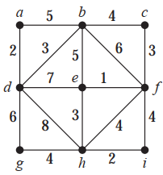
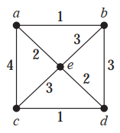
Prim’s Algorithm Exercise

